Slide 1


Necro Nursery
Team Abra-cadaver

Slide 2
Narrative
Heavy work on updating world bible
Added monsters to world bible
Made edits/comments where confusion was happening
Fleshed out origins of necromancy and origins of things we created
Worked on miscommunication
Confusion was happening within some elements of the narrative that were not consistent with the lead designer’s vision

Slide 3
Audio
Completed sound effects for everything currently developed
Will adjust sound effects if changes happen
Started mixing music
Completed most songs’ score

Slide 4
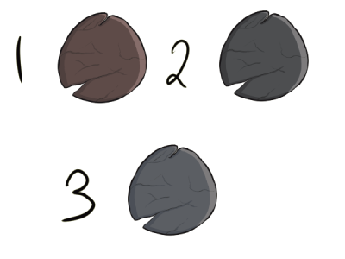
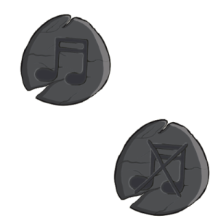
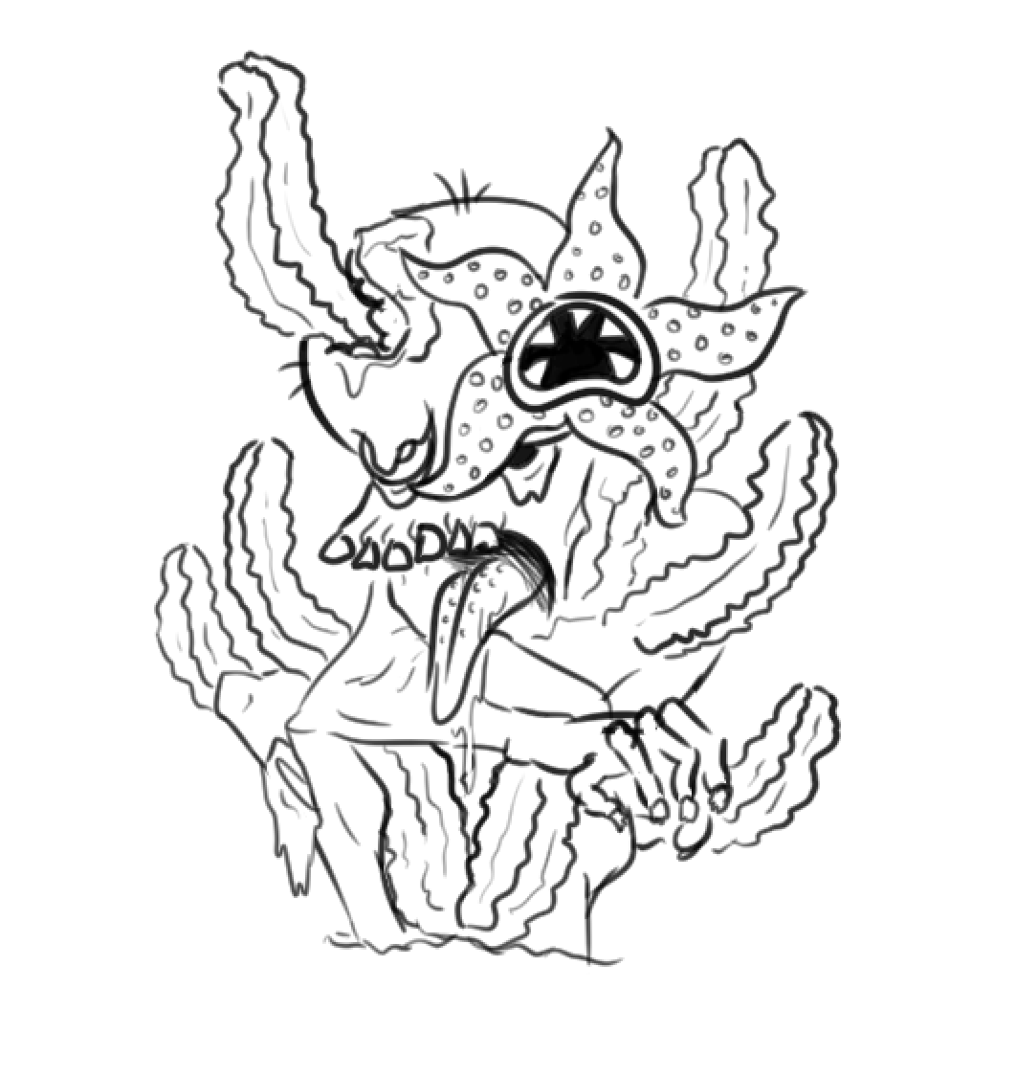
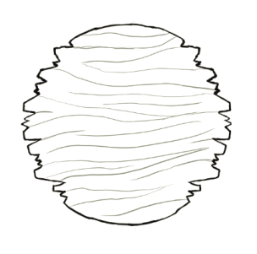
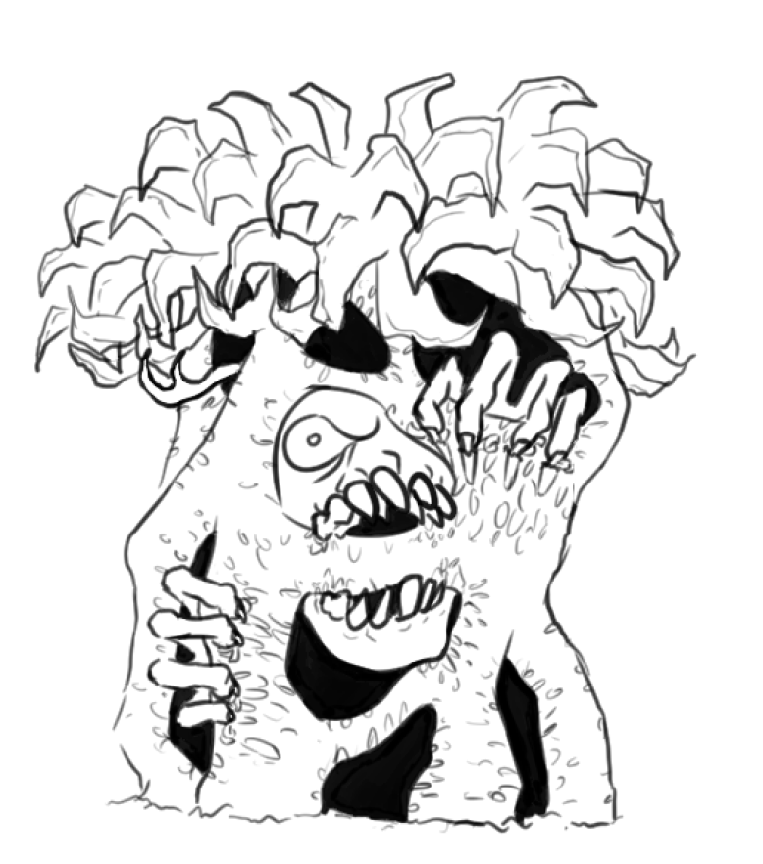
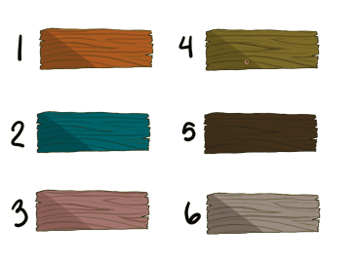

Slide 5
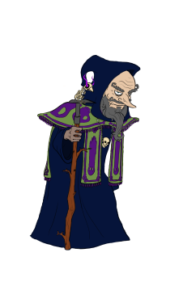
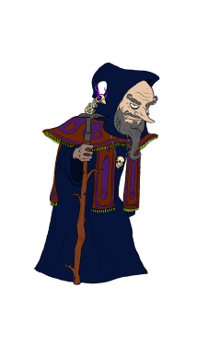
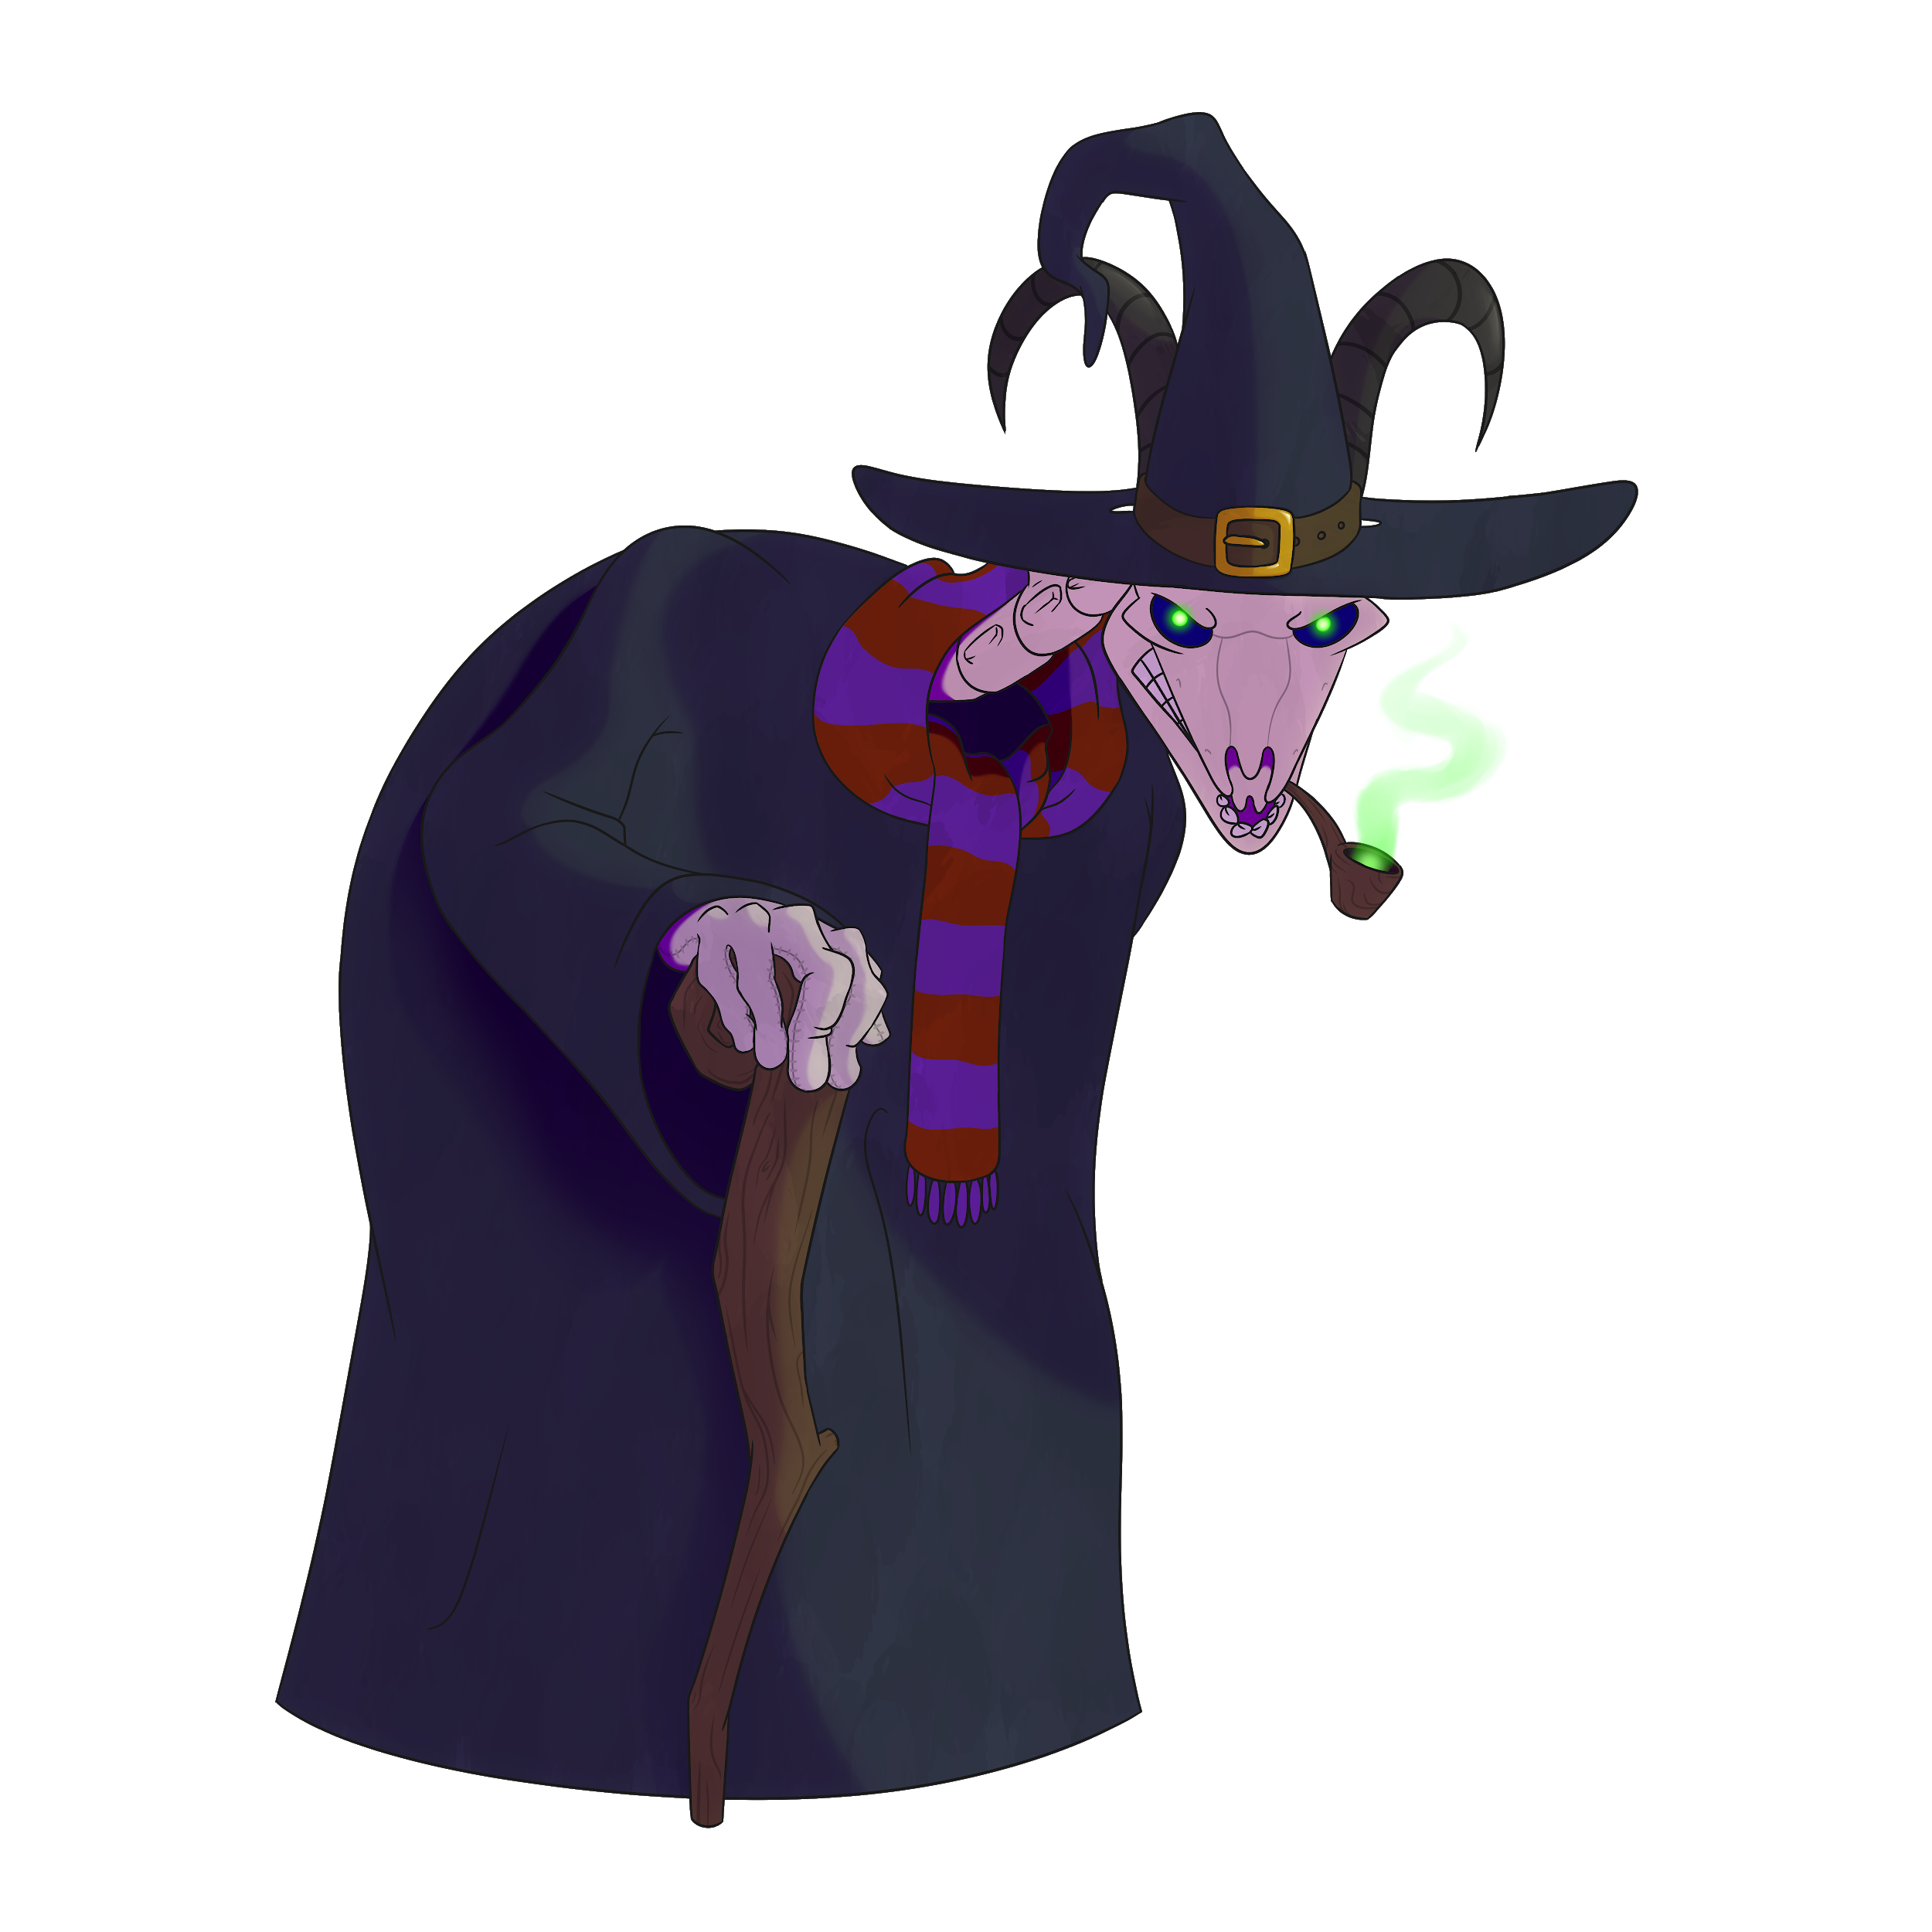
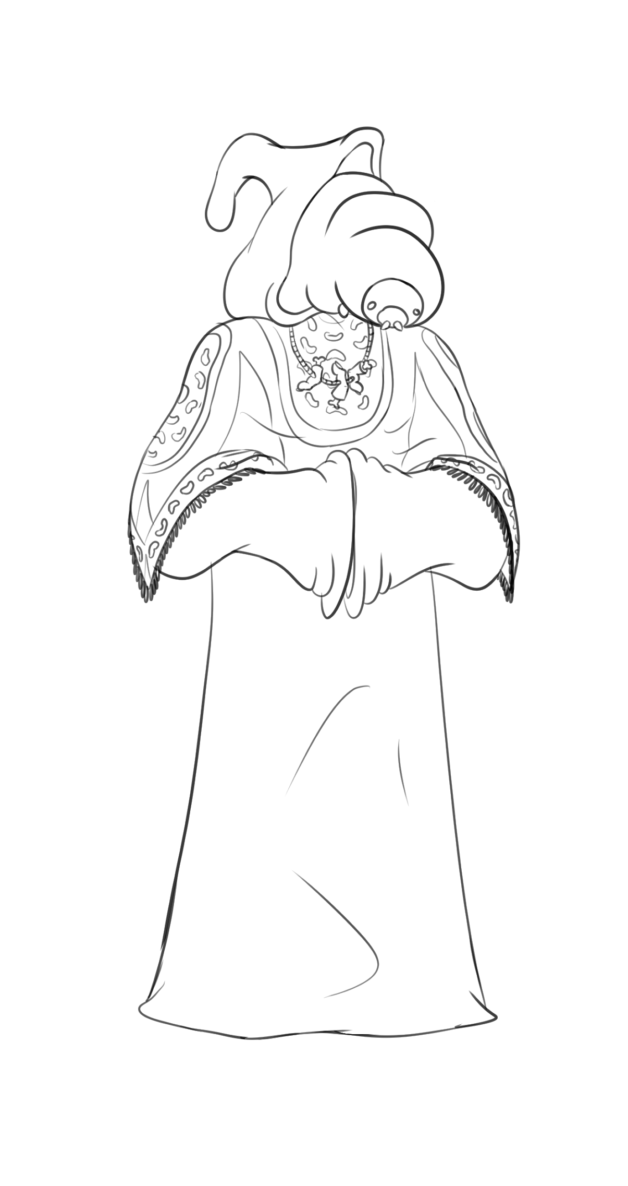
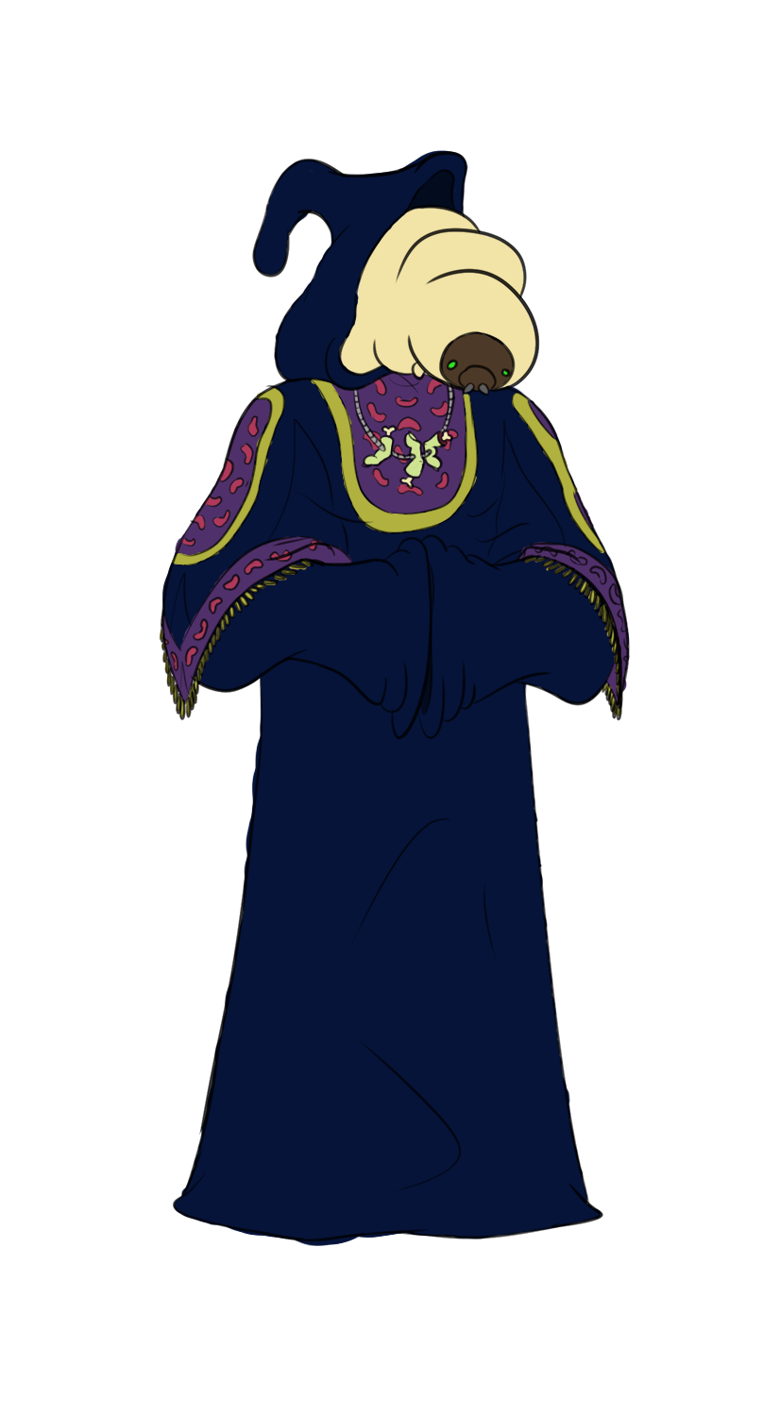
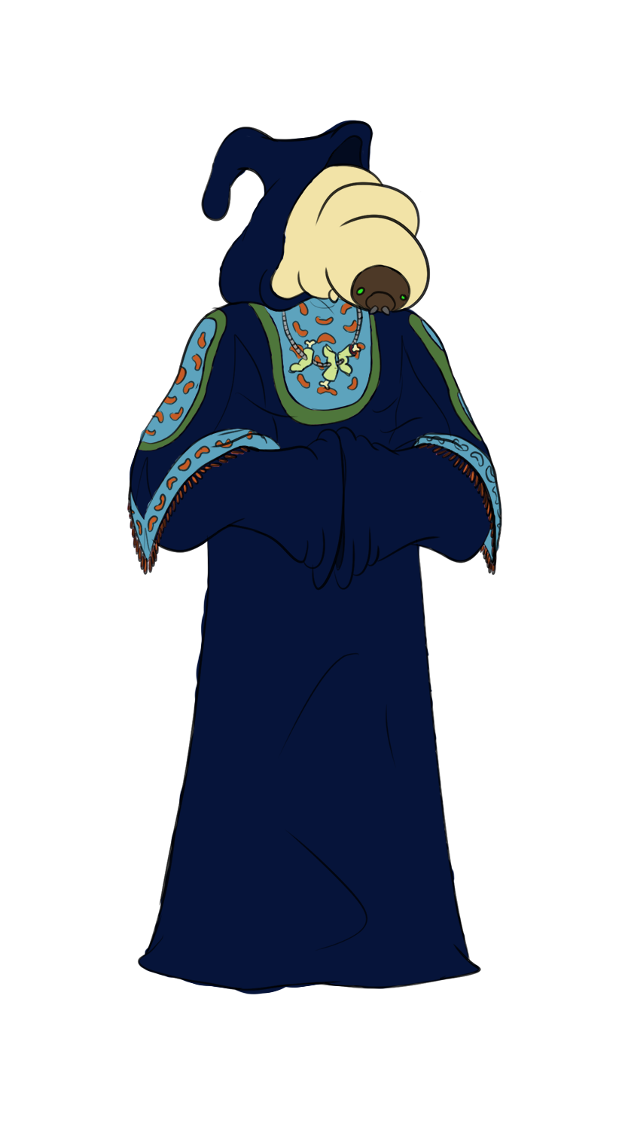
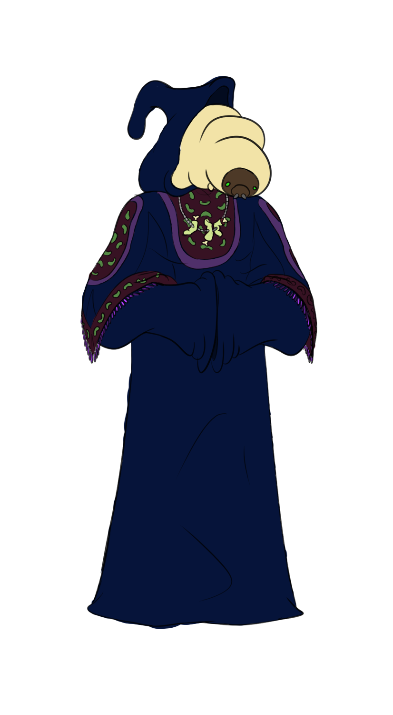
Mentor Palette Concepts
Elder Asset
Final Merchant Concept
Merchant Palette Concepts

Slide 6
Programming
Morgue Minigame
“Wanted” list of body parts
Collecting required body parts + WIN/LOSE
Grave / Monster Prefab - Officially cycles all stages
Saving in the works
Started touch to draw research

Slide 7
What we plan to do!
Make world bible consistent with lead designers vision
Complete all songs so mixing can begin with all of them
Start research on second minigame coding methods (Drawing)

Slide 8

Troubles along the way?
Miscommunication
Plugin issues

Slide 9
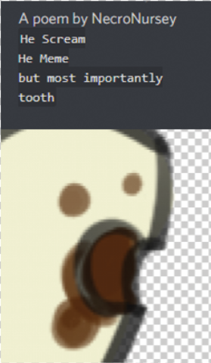
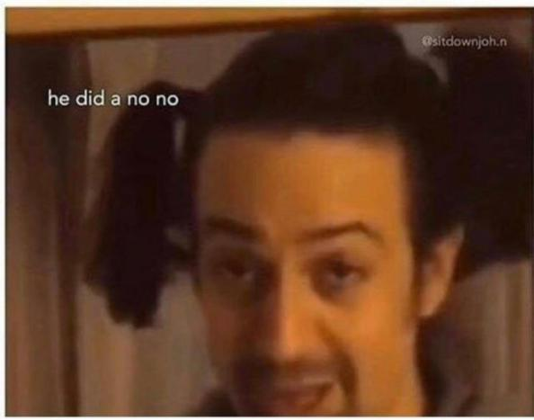

Questions?

